Slide 1


Eastern Region Residential Care Providers Event
COMMISSION EAST
WEDNESDAY, 18 JUNE 2025
10:00 – 15:00

Slide 2


Today's Agenda
Time | Item | Lead
09:30 | Refreshments
10:00 | Welcome & introductions | Sarah-Jane Smedmor
10:15 | You said, we did | James Tennant
10:45 | Our Partnership | Jonathan Stanley
11:45 | Break
12:00 | Our Partnership Values – Exercise | Jonathan Stanley
12:45 | Lunch
13:45 | Legislation & Policy | Kathy Evans
14:30 | Q&A Panel | Group
14:50 | Close Feedback & Forward Look | Sarah-Jane Smedmor

Slide 3
Welcome..
Sarah-Jane Smedmor
Commission East Lead
Executive Director of Children & Young People's Services
Suffolk County Council

Slide 4

Welcome & Purpose of Today
Ensuring that every child has the opportunity to thrive, irrespective of their background or circumstances, is not only our professional mission but a moral imperative we all share.
In the Eastern Region, we understand that achieving this goal requires collaborative effort.
Today is dedicated to fostering connections, enhancing communication, and building upon our collective work to ensure all our children in the East have the best opportunities.

Slide 5


Regional Position – Residential
Total Children's Home settings in Eastern Region | 345
Eastern Regions settings used by Eastern Region LAs | 170
% used by Eastern Region LAs | 49%
Total bed capacity in Eastern Region | 1477
Eastern Regions beds used by Eastern Region LAs | 394
% used by Eastern Region LAs | 27%
% not used by Eastern Region LAs | 73%
The Eastern Region spent over £300m with children’s social care providers for the year 23/24 and we think that if we organise ourselves better, we can improve both the operational and commercial arrangements between LAs and Providers, that will in turn help us deliver the best outcomes for the children we look after.
*Capacity data based on FYE March 25 and Cost data based on FYE March 24

Slide 6
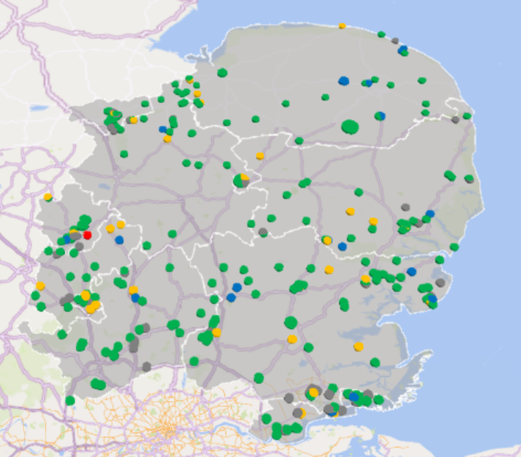
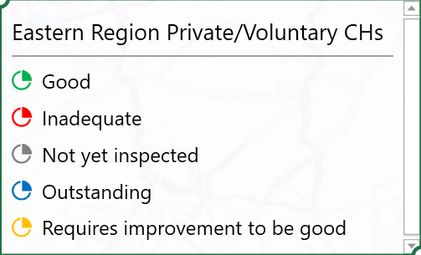
Eastern Region distribution of Providers - Ofsted rating
*Based on Ofsted data May 25

Slide 7
Commission East – What
Commission East is an Eastern Region initiative designed to engage with the market differently, with a focus on establishing a single Local Authority (LA) voice, and perspective for the region.
It represents a collaboration among 11xLAs that consent to and support targeted activities aimed at fostering more cohesive regional strategies and frameworks.
It serves as a regional platform to connect with the market and collaborate with LAs at the regional, sub-regional, and local levels.
Name change ! Eastern Regional Care Collaborative >>> Commission East
Commission East consists of a small project team that collaborates with all commissioners, practice leads and relevant stakeholders across the 11 LAs.
Include Map??

Slide 8
Commission East - Vision
Our vision is to create a resilient and sustainable system of care that ensures every child and young person has access to the right placement, at the right time, within their local community.
As a corporate parent we have both a legal and moral responsibility towards our children in the same way that any parent would have with their own child. Therefore , we must strive, as with any parent, to fulfil our parental responsibilities to the highest standard. We want our children and young people to have happy and healthy childhoods, where no child is left without the support, they need to enable them to thrive, pursue their aspirations and to create a strong sense of belonging and self-worth that will continue into their adult life.
Our mission is to provide a diverse range of high-quality, stable, and nurturing environments that meet the unique needs of children and families and to reach this we have developed three strategic areas of focus to help design, develop and deploy transformational change across the sector. However, we need to work together and make this everyone’s business, engaging hearts and minds across the region and creating better commissioning relationships to improve innovation and collaboration with all our partners.

Slide 9
Commission East – Values
Purpose: Care Matters, we are proud to make a difference for the Children, Families and the Communities we serve.
Ambitious: Striving for the best possible outcomes and being deeply committed to making a positive difference in the lives of children and young people.
Innovative: We are open, we share and learn to challenge traditional approaches, relentlessly pursuing ideas to improve the services we deliver.
Together: We listen and contribute, whilst embracing creativity and collaboration to achieve our common purpose.

Slide 10
James Tennant
Commission East - Programme Manager

Slide 11

Commission East Programme
To achieve impactful and sustainable outcomes by delivering activity that is well-planned, effectively administered and aligned with the needs of stakeholders and the strategic direction of Commission East.
Providing high-quality solutions that make a meaningful difference for children, families, and communities.

Slide 12
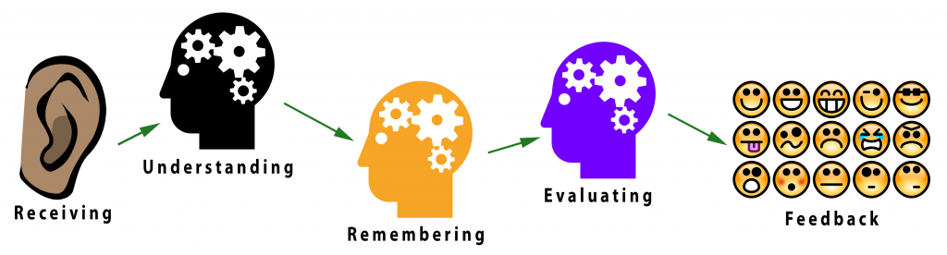
You said, we did, we’re doing, we’re going to do!
Greater LA representation
Regional Placement Request Form
Simpler commissioning arrangements
Developing a more common language / approach
Clear escalation routes for operational issues
Created the Eastern Collaborative Childrens Residentila Network (ECCRN)
Better relationships

Slide 13
Commission East: Strategic Themes
Vision
Our vision is to create a resilient and sustainable system of care that ensures every child and young person has access to the right placement, at the right time, within their local community
Values
Purpose, Ambitious, Innovative, Together
Strategic Themes
1. Regional Commissioning | 2. Practice Development | 3. Data Insight and Demand Management
Aim: To Improve overall capacity and value for money to ensure there is sufficient provision of residential placements to meet a range of needs, particularly complex disabilities, as close to home as possible. To also ensure that there remains a sufficiency of other accommodation-based support. | Aim: Provide comprehensive training and development opportunities for staff to deliver consistent, high-quality care. Fostering a culture of continuous learning and professional growth within the workforce that embed child centre cultures and embrace innovation to meet he the ongoing challenges of sufficiency. | Aim: To develop a continuous oversight of our sufficiency requirements through systematically gathering key data on social care needs, spend and trends to enable us to plan for future service demand and identify where there is a need for new or changed services. To then use this together with our market intelligence to work with providers and partners to develop this capacity.​

Slide 14

Karen Faulker
CCRAG Lead Officer
The CCRAG database holds details of all Ofsted registered provision.
It matches placements to vacancies by location and need
It is FREE for providers to register and promote their services.
You can send Local Alerts to Local Authority placement teams to support keeping children local

Slide 15
Commission East: Governance structure

Slide 16





ERCC - High Level 5 Year Plan
Year 1
Foundation, Strategic Planning & Phase 1 Commissioning
Year 2
Expansion & Capacity Building
Year 3
Capital & Joint Delivery Models
Year 4
Integration & Policy Advocacy
Year 5
Performance Optimisation &
Sustainability
Governance & Leadership
Infrastructure Development
Stakeholder Engagement
Exploring new commercial arrangements
Capital Discovery
Data-Driven Decision Making
Technology Enhancement
Develop new Regional commissioning structures
Capital Development
Capital Deployment
Phase 1 of Co Commissioning models - Specialist Services
Coordination & Integration
Regulatory & Policy Development
Phase 2 of Co Commissioning Models
Sustainability & Financial Viability
Continuous Improvement - CYP Outcomes
Future Planning
Benefits Realisation
Workforce Development
Funding and Sustainability

Slide 17
Year 1
Foundation, Strategic Planning and Phase 1 Commissioning
Activity – closer look

Slide 18


1. Regional Commissioning
1 | Regional Commissioning | RO | Purpose | Work Started | Project Life cycle
 | Working with the market differently | Andrew Rome & James Tennant | Improve value for money by creating more cost-effective arrangements that secure better outcomes from the market | Yes | Design
 | Create Regional approach for Specialist Services | James Purdie (Thurrock) | Improve Specialist offer, across different specialist areas, CWD, Edge of Tier 4, T4 | Yes | Design
 |  | Lindsay Baron Tina Hines
 | Separated Migrant Children | Clare Burrell (Essex) | Create a regional strategy for SMC | Yes | Definition
 | Commissioning Frameworks | Cambridge | Create commissioning efficiencies, clarity with external providers and promoting outcome-based behaviours. $ x lots with different LAs leading on each area. but reporting to one F/W meeting chaired by RO | Yes | Design
 | Create regional Placement Request Form | Luton | Create consistency across region with external providers. (This came from provider feedback from event on 31st) | Yes | Definition
 | Unregulated Provision | TBC | 1. Reduce the use of unregulated providers | No | Backlog
 |  |  | 2. Create assurance mech when used.
 | Estate Analysis | James Tennant | Reduce the use of unregulated providers and create assurance mech when used. | No | Backlog
 | IFA - Engagement | TBC |  | No | Backlog

Slide 19
2. Practice Development
2 | Practice Development | RO | Purpose | Work started | Project Life cycle
 | Regional Registered Managers Network Meetings | Steve Gentry and Helen Hancock | Equip RMs with knowledge and tools to create excellent homes for children | Yes | Delivery
 | Practice Principles | Hazel North-Stephens (Essex) | Create operational expectations that promotes consistent behaviours across internal and external providers | Yes | Design
 | Child Need Descriptor | TBC | Create a common language to describe need, operationally at service level and strategically across region. | Yes | Discovery
 | One Page Profile | Saleha Khanam (Luton) Veronica Bennet (Herts) | Improve child centred approaches, based on strengths as well as risks | Yes | Design
 | Recruitment & Retention | Rachel Black (SLI Lead) | Develop regional strategy for R&R, including training and development opportunities | Yes
 | Edge of care | TBC | Promote best practice across region | Yes | Design
 | Create Outcomes Framework?? | Cambridge | Give regional focus on all activity (links to data and demand) | Yes | Definition
 | Data Sharing with Health (Mini Pilot) | Rachel Black (SLI Lead) | Share information between health and SC | Yes | Delivery
 | Research and best practice | Commission East and Jonathan Stanely | Need to define. | Yes | Definition
 | Regional Registered Managers Network Meetings | Steve Gentry and Helen Hancock | Equip RMs with knowledge and tools to create excellent homes for children | Yes | Delivery

Slide 20
3. Data Insight & Demand Management
3 | Data Insight and Demand Management | RO | Purpose | Work Started | Project Life cycle
 | Create a regional sufficiency data pack | Michael MacAlister | Inform strategic decision making | Yes | Definition
 |  |  | Promote best practice | Yes
 |  |  | Align resource to the right activity | Yes
 | Create data assurance group | James Tennant | Sense check date entry and understanding - are we describing, recording and presenting information in the same way. | Pending
 | Bespoke Reporting for projects | TBC | Project impact and analysis
 | Automation | Paul Dryden | How can we use automate and help improve data quality.

Slide 21
Jonathan Stanley
National Centre for Excellence for Residential Child Care

Slide 22

Eastern Collaborative Children’s Residential Network
THE ROAD AHEAD

Slide 23

The road ahead
The Collaborative is the result of a realisation about commissioning.
Reviewing long-held values, objectives, or methods means engaging in collaborative thinking and collaborative exploration to find new and more appropriate approaches and put them into operation.
We are having to find new understanding, language and practice.
We are in a transition. There is transitional learning.

Slide 24

Transitional learning is inevitable
Transitional learning = trying out new ideas, honing, or modifying them, so they become workable and steering the whole developmental process around inevitable obstacles while ensuring that it continues to go in the direction that is needed.
We might find ourselves testing out, working through, and design anew.

Slide 25
Levy and Merry 1986 Organisational transformation (amended
Stanley 2025)
Today
Not doing it all
Taking some small yet important steps together
First order change – the immediate | Second order change – the road ahead
Change in one or a few dimensions, components or aspects | Multi-dimensional, multi component change an aspects
Change in one or a few levels (individual or group level) | Multi-level change (individuals, groups and the whole organisation)
Change in one or two behavioural aspects (attitudes, values) | Changes in all the behavioural aspects (attitudes, norms, values, perceptions, beliefs, worldview and behaviours)
Quantitative change | Qualitative change
Change in content | Changing context
Continuity, improvements, and development in the same direction | Taking a new direction
Incremental changes | Evolutionary change
Reversible changes | Irreversible change
Logical and rational change | Different logic
Change that does not alter the worldview coma the paradigm | New world view, new paradigm
Change within the old state of being (thinking and acting | Change in a new state of being

Slide 26
Relational Commissioning (Petrie and Wilson)
A shared identity and common value system; mutual dependence and trust; risk-sharing; a presumption of the incompleteness of the contract; a commitment to managing contractual arrangements; and to extensive communication.
Relational contracting requires
An appreciation that personal, professional and social values influence the nature and process of the working relationship
The importance of building relationships over time, trust has to be established or anticipated - there has to be a history and a future.
Mutual trust is greater than individual self-interest

Slide 27
Mindset -
Systems thinking,
Thinking systems
A system is an ensemble of interdependent and interacting parts that is actively organised in terms of the goal
Primary task = the way the systems proposes to engage with these aims
Creating, finding, or discovering new, more adaptive and viable, ideas and ways of thinking and acting collaboratively

Slide 28
The difference of the collaborative approach.
Making the change from the transactional to the relational.
Transactional – two systems acting on each other, the parts relating to each other (at every level)
Commissioners and providers may have different definitions of the primary task
Relational - one system with 2 sub-systems acting together, neither has ascendancy

Slide 29
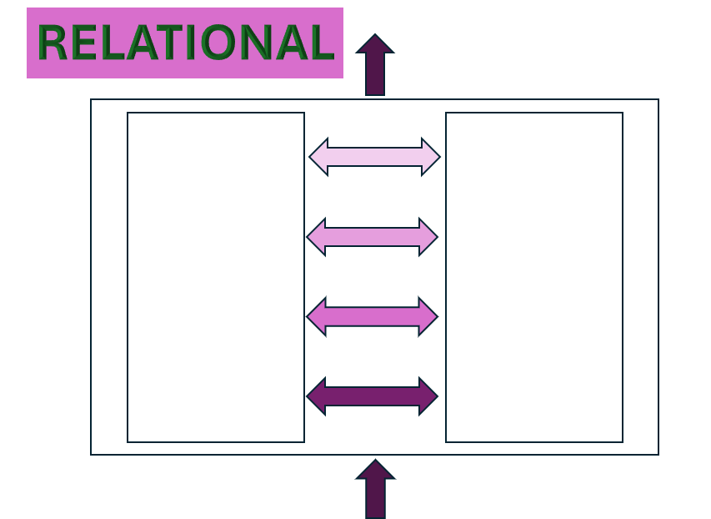
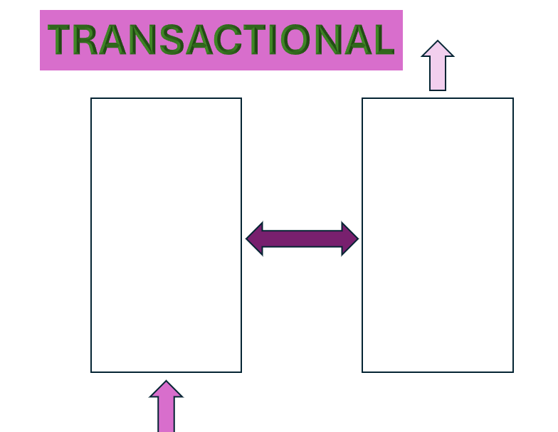

Slide 30
From NCERCC Commissioning is a parenting and child care activity (2010) - Creating the relational
Key elements of commissioning:
Commissioning is about enhancing the quality of life of service users & their carers by:
Shared values that acknowledge individual diversity
Awareness of current and future service user needs
Detailed mapping of available services
A vision for better addressing local needs
A strategic framework for service procurement within political guidelines
Integration of relevant financial and outcome data
Ongoing communication with service users, carers, and providers
Efficient systems for implementing service changes
An evidence-based approach to evaluate and improve services
Better alignment with other health and social care commissioning methods
having the vision and commitment to improve services
connecting with the needs and aspirations of users and carers
making the best use of all available resources
understanding demand and supply
linking financial planning and service planning

Slide 31
Ambitions affected by demands outside of the parenting & child care task - Creating the transactional
3 E’s :
Economy
Efficiency Effectiveness
4 C’s :
Challenge Comparison Consultation Competition
A definition of commissioning that encompasses procurement, purchasing, and contracting, which can sometimes become ends in themselves and may not inherently progress towards relational commissioning
Other terms used to describe commissioning, but which are not commissioning in themselves include:
Procurement: sourcing, selection, securing services.
Purchasing: buying services.
Contracting: one specific part of the wider commissioning process – the selection, negotiation and agreement with the provider of the exact legally binding terms on which the service is to be supplied.
Commissioning: the process of specifying, securing and monitoring services to meet individuals' needs.

Slide 32
‘Relational contracting is underpinned by interaction, negotiation, flexibility and mutual trust rather than by sanctions and penalties, and this goes to build the ‘contractual community of interest’
Effective contractual relationships
Mutual advantage
Success with difficult to meet needs cases
Pivotal, respectful relationships between key senior staff members
Collaborative relationships at lower levels of staff
The Walsh report identified 4 connected factors for effective contractual relationships

Slide 33
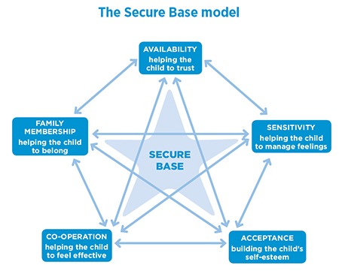
Commissioning a secure base.
The model proposes five dimensions of caregiving, each of which is associated with a corresponding developmental benefit for the child. The dimensions overlap and combine with each other to create a secure base for the child

Slide 34
Relational Commissioning – paradigm shift = facilitator, enabler or connector
Thinking differently about commissioning Kings Fund (2022)
Different language to describe the role, for example, being a ‘facilitator’, ‘enabler’ or ‘connector’. The ideas add up to a paradigm shift in thinking about their role and how to drive improvement in health and care services.
Bringing stakeholders together to make decisions;
Fostering close operational partnership between commissioners
and providers.
Simplifying financial arrangements.
Offering improvement support to providers.
A new ethos of commissioning

Slide 35
Summary so far – developing relational commissioning requires the current activity of commissioning to be transformed
Shifting
Shifting from product to learning;
Developing
Developing explicit skills, attitudes, and abilities as well as knowledge;
Assessing
Developing appropriate assessment procedures;
Rewarding
Rewarding transformative practice;
Encouraging
Encouraging discussion of practice of both commissioner and provider;
Learning
Providing transformative learning for all commissioners and providers
Fostering
Fostering new collegiality;
Linking
Linking quality improvement to learning;
Auditing
Auditing improvement.

Slide 36
Exercise 1: Our collective values
Here is a list of potential values for bonding commissioners and providers:
Acceptance Achievement Advancement & Promotion Adventure Affection Altruism Arts Awareness Challenge Change Community Compassion Competence Competition Completion Connectedness Cooperation Collaboration Creativity Decisiveness Democracy Design Discovery Diversity Emotional Security Economic Security Education Effectiveness Efficiency Elegance Entertainment Enlightenment Equality Ethics Excellence Excitement Experiment Expertise Exhilaration Fairness Family Happiness Friendship Fun Grace Growth Harmony Health Helping Others Helping Society Honesty Humour Imagination Improvement Independence Influencing Others Inspiration Integrity Intellect Involvement Knowledge Leadership Learning Loyalty Magnificence Making a Difference Mastery Meaningful Work Ministering Money Morality Openness Originality Order Passion Personal Development Personal Expression Planning Play Pleasure Power Professional development Quality Recognition Relationships Reputation Responsibility Risk Safety & Security Self-Respect Sensibility Service Sophistication Spark Speculation Stability Success Teaching Tenderness Thrill Unity Variety Wisdom
Using Slido – please pick your top 4 or select own top 4 words you wish to put forward.

Slide 37



Do not edit
How to change the design
What 4 key words would you use to align our values going forward? Words on screen.
The Slido app must be installed on every computer you’re presenting from

Slide 38
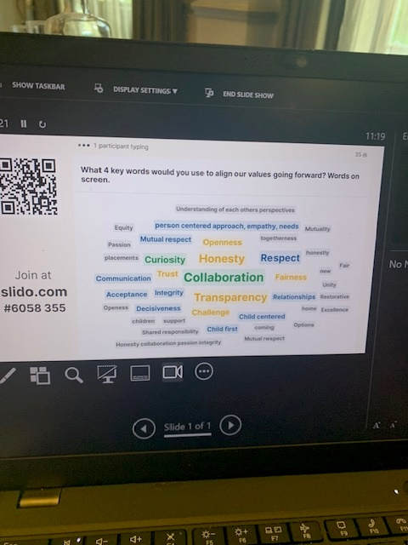

Slide 39

Values & Practice Principles

Slide 40
Exercise 2 : Creating better links.
Objective:
In your table groups, please discuss and describe what “better links” mean to you in the following areas:
Focus Areas
Communication with commissioners
Communication with social workers
Communication with operational teams
Training and events
Any other areas you feel are important
At our last event, you mentioned wanting stronger connections with your local authority. Let’s take this opportunity to explore what improvements we could make together. Are there specific actions we can identify and take forward to strengthen those links?

Slide 41

Creating Better Links - Feedback & discussion

Slide 42


From competitive markets to
caring collaboration
Kathy Evans
NYAS Director of Policy & Influencing
Former CEO of Children England
Human Learning Systems Collaborative

Slide 43
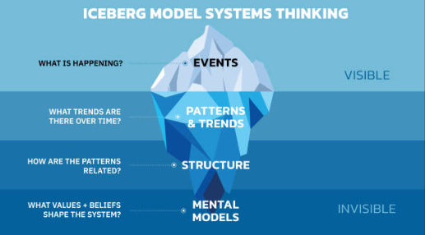
System change needs system thinking

Slide 44
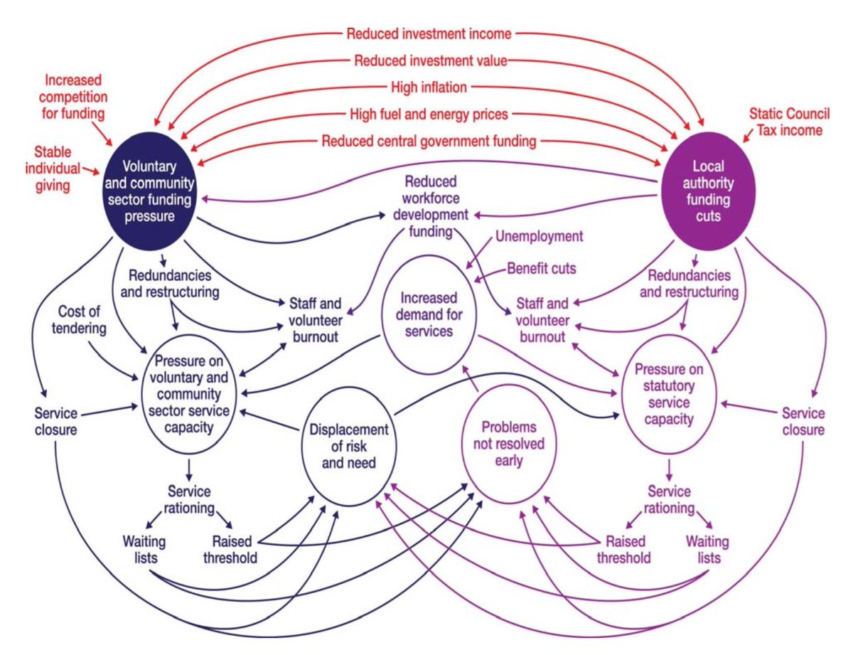
“I see systems…..”

Slide 45
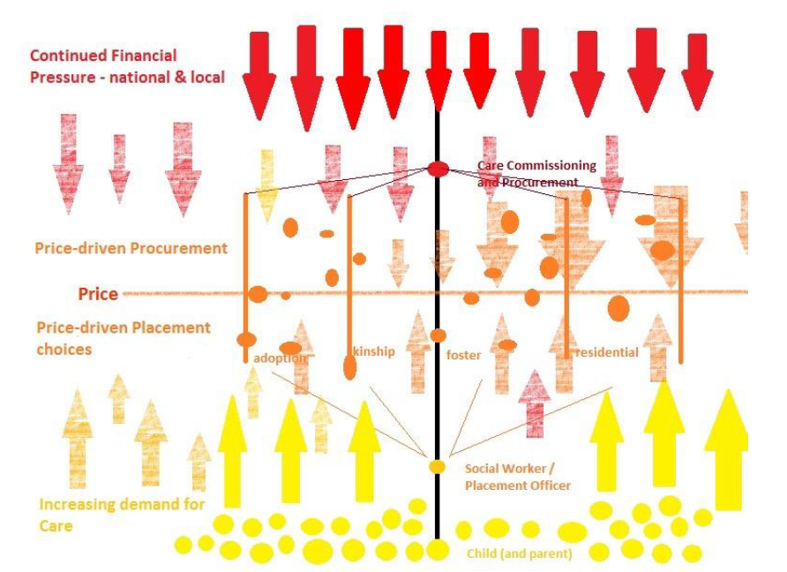
“I see systems…..”

Slide 46
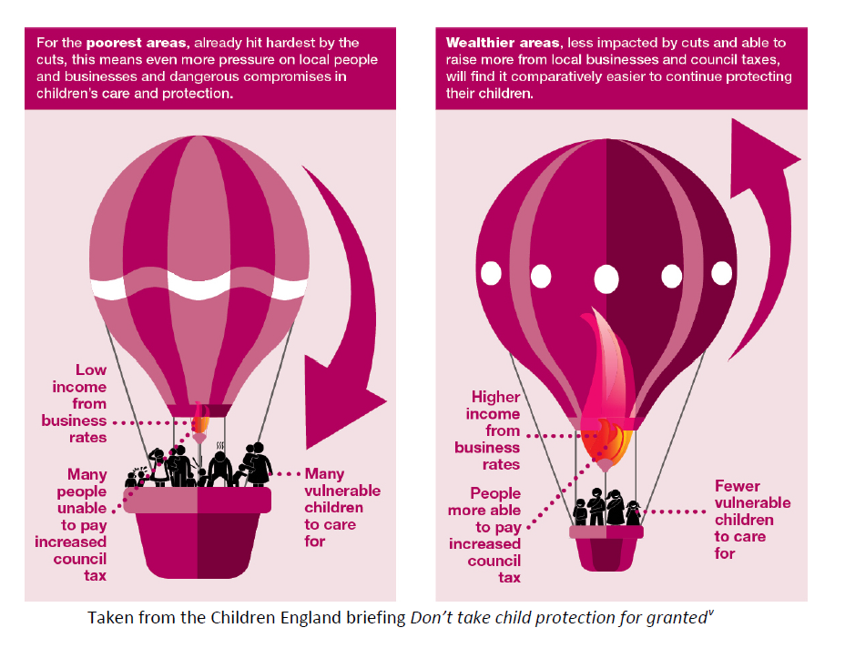
“I see systems…..”

Slide 47

“I see systems…..”

Slide 48

“I see systems……”
The children’s care ‘placement’ market
2004 - 2025

Slide 49
My Little Heresy (Kittens are Evil 2016)
Public Service Markets CAN’T work
The more you use market competition and disciplines to try to make public services more efficient, the more you drive the market towards collapse, or new monopolies and cartels

Slide 50
Why are public services destined for market failure?
Market distortion – I am the one and only….. paying customer
Externalities – Unaccounted for/uncosted factors outside of the market transaction will cause damage
3. Public Goods – think of Lighthouses!

Slide 51
Why business ‘tenets’ don’t work, or help in organising public purpose
In business demand is always a good thing

Slide 52
Why business ‘tenets’ don’t work, or help in organising public purpose
In business repeat custom
is brilliant!

Slide 53
Why business ‘tenets’ don’t work, or help in organising public purpose
In business loan capital can unlock new income by meeting high demand

Slide 54
Why business ‘tenets’ don’t work, or help in organising public purpose
Cost, price and value are [importantly] different things

Slide 55
Why business ‘tenets’ don’t work, or help in organising public purpose
In business price is a reasonable gauge for value

Slide 56
Why business ‘tenets’ don’t work, or help in organising public purpose
Care is not a product,
it is a verb

Slide 57
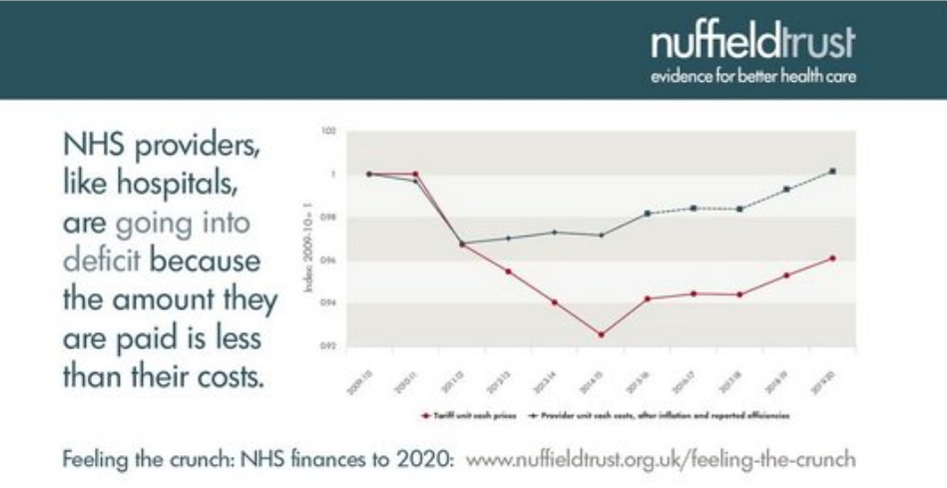
Why business ‘tenets’ don’t work, or help in organising public purpose
Unit purchasing, costing & pricing is like nitrous oxide in a fuel tank, accelerating market collapse

Slide 58
Why business ‘tenets’ don’t work, or help in organising public purpose
In commercial markets SCARCITY DRIVES UP MARKET VALUE

Slide 59
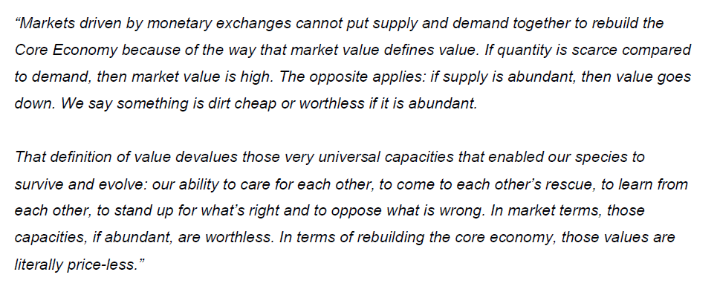
Edgar Cahn (US economist)

Slide 60

Take the Red Pill!
Competitive markets in public services are a SIMULATION
We can change them if we choose to. And we must.
Markets don’t care about children
People Do!

Slide 61

We have all the right people, just not in the right relationships

Slide 62

From Competition to Collaboration

Slide 63
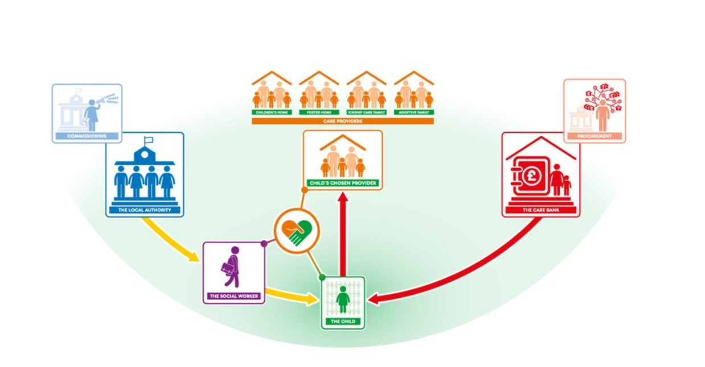
From Competition to Collaboration

Slide 64
Do the right thing, not the easy thing
“As systems guru Russell Ackoff explained, if you are doing the wrong thing then doing it better makes you wronger, not righter…..
On the other hand, if you are doing the right thing wrong, then every step of improvement is a step in the right direction”
Simon Caulkin

Slide 65
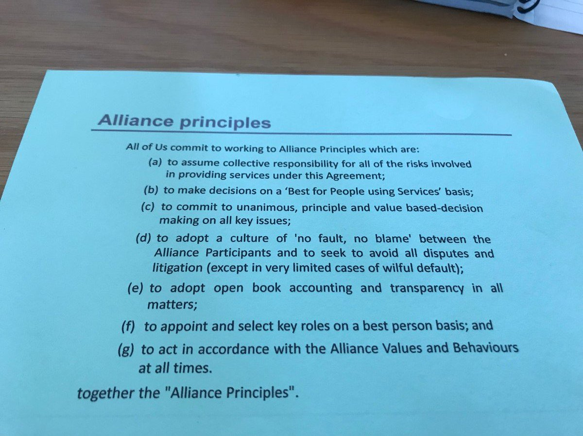
(Collaborative) Alliance Contracting

Slide 66
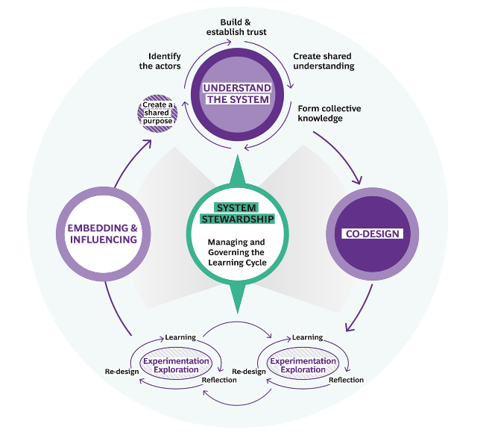
Human Learning Cycles

Slide 67
Panel:
Sarah-Jane Smedmor
Jonathan Stanley
Kathy Evans
You!
Panel Q&A

Slide 68

Sarah-Jane Smedmor
Forward look and
Thank you

